Slide 1

Home
Notes:
textbox
No alt text provided
shape
No alt text provided
actionButton
No alt text provided

Slide 2
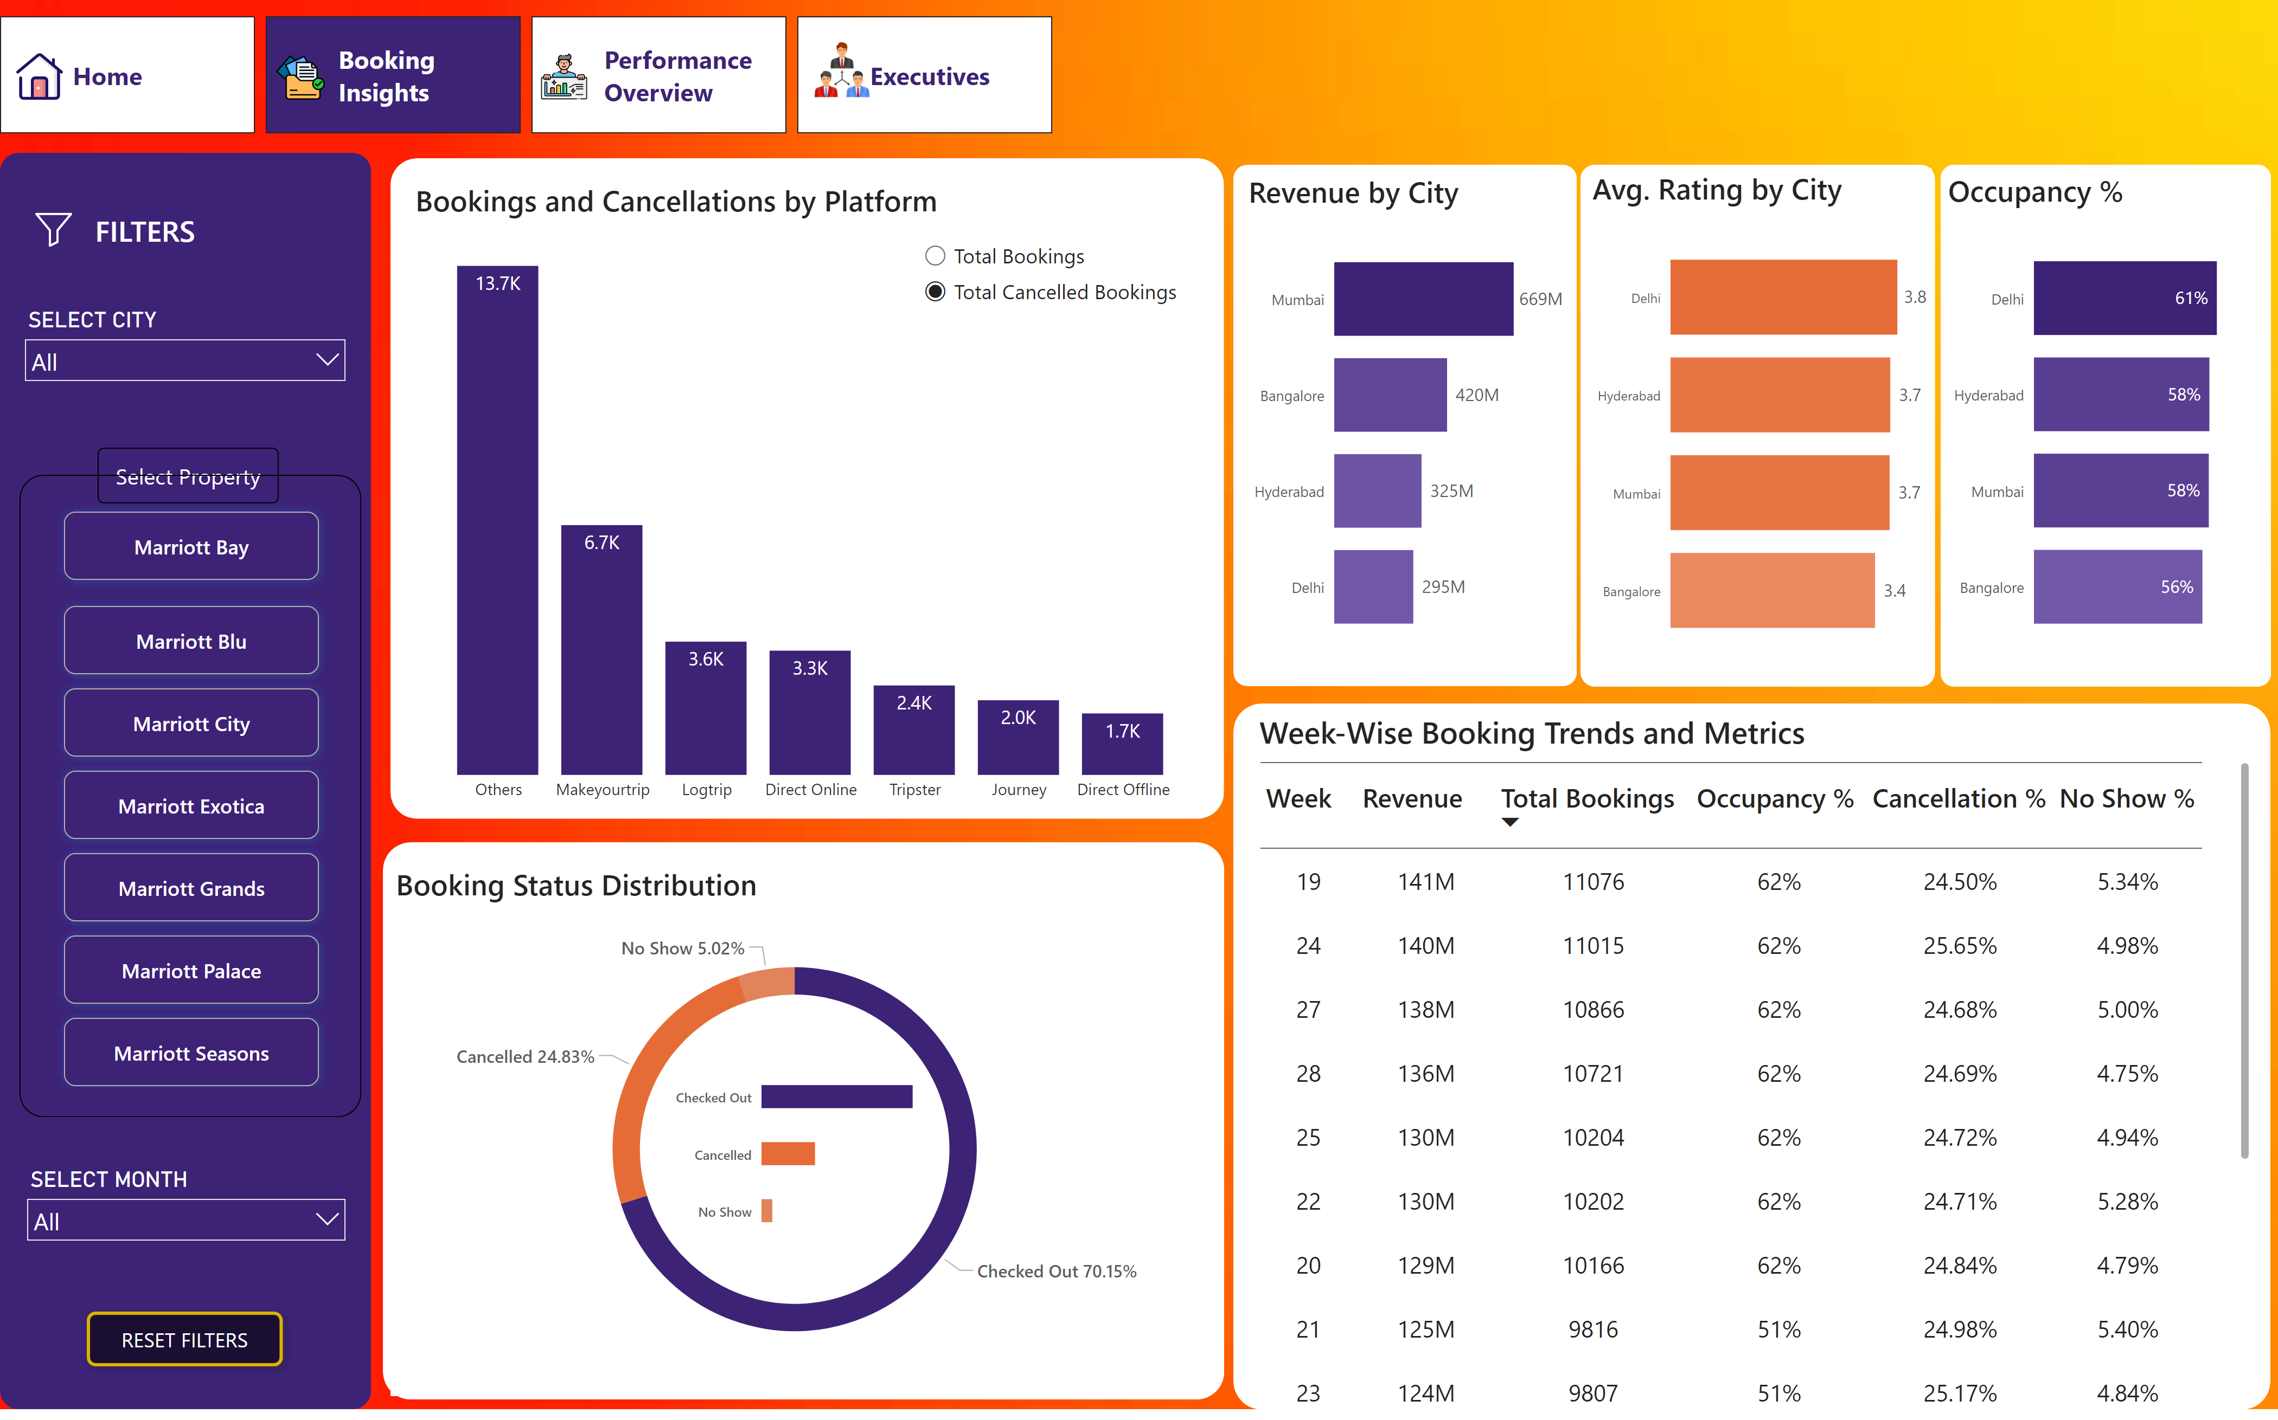
Booking Insights
Notes:
slicer
No alt text provided
Bookings and Cancellations by Platform
No alt text provided
shape
No alt text provided
shape
No alt text provided
shape
No alt text provided
slicer
No alt text provided
advancedSlicerVisual
No alt text provided
shape
No alt text provided
shape
No alt text provided
slicer
No alt text provided
actionButton
No alt text provided
Revenue by City
No alt text provided
shape
No alt text provided
clusteredBarChart
No alt text provided
Booking Status Distribution
No alt text provided
Avg. Rating by City
No alt text provided
shape
No alt text provided
Occupancy %
No alt text provided
shape
No alt text provided
Week-Wise Booking Trends and Metrics
No alt text provided
shape
No alt text provided
pageNavigator
No alt text provided
image
No alt text provided
image
No alt text provided
image
No alt text provided
image
No alt text provided
image
No alt text provided
actionButton
No alt text provided

Slide 3
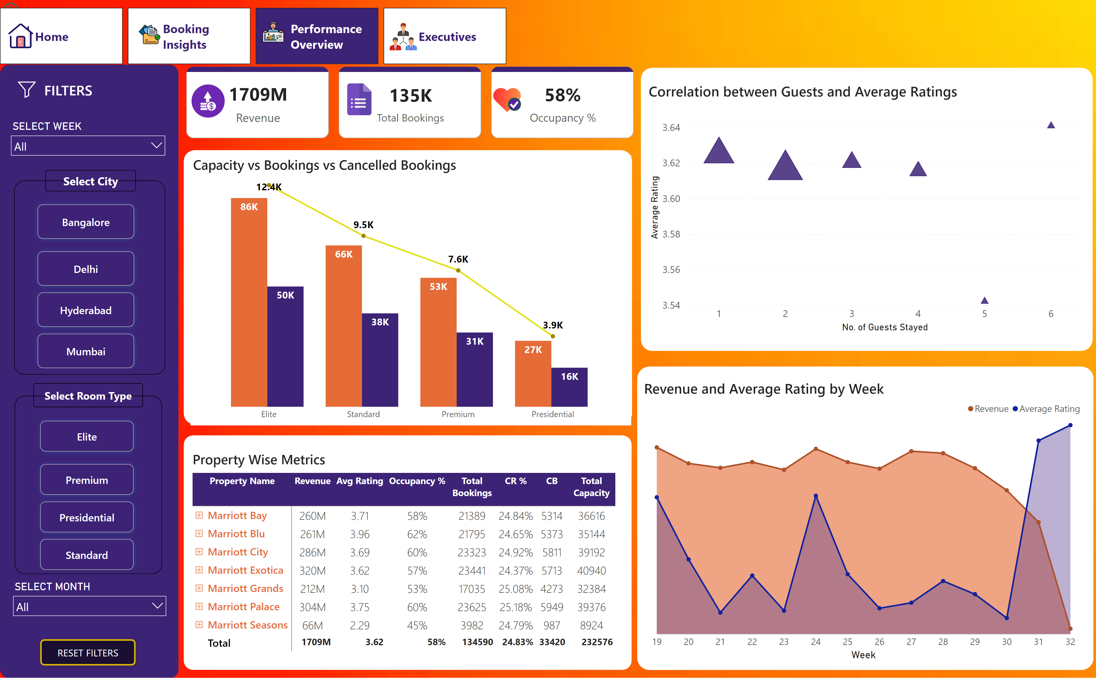
Performance Overview
Notes:
shape
No alt text provided
slicer
No alt text provided
advancedSlicerVisual
No alt text provided
shape
No alt text provided
shape
No alt text provided
slicer
No alt text provided
actionButton
No alt text provided
room type slicer
No alt text provided
Room type shape
No alt text provided
shape
No alt text provided
Correlation between Guests and Average Ratings
No alt text provided
shape
No alt text provided
areaChart
No alt text provided
shape
No alt text provided
Property Wise Metrics
No alt text provided
shape
No alt text provided
actionButton
No alt text provided
Capacity vs Bookings vs Cancelled Bookings
No alt text provided
shape
No alt text provided
image
No alt text provided
cardVisual
No alt text provided
cardVisual
No alt text provided
cardVisual
No alt text provided
image
No alt text provided
image
No alt text provided
pageNavigator
No alt text provided
image
No alt text provided
image
No alt text provided
image
No alt text provided
image
No alt text provided
image
No alt text provided
actionButton
No alt text provided

Slide 4
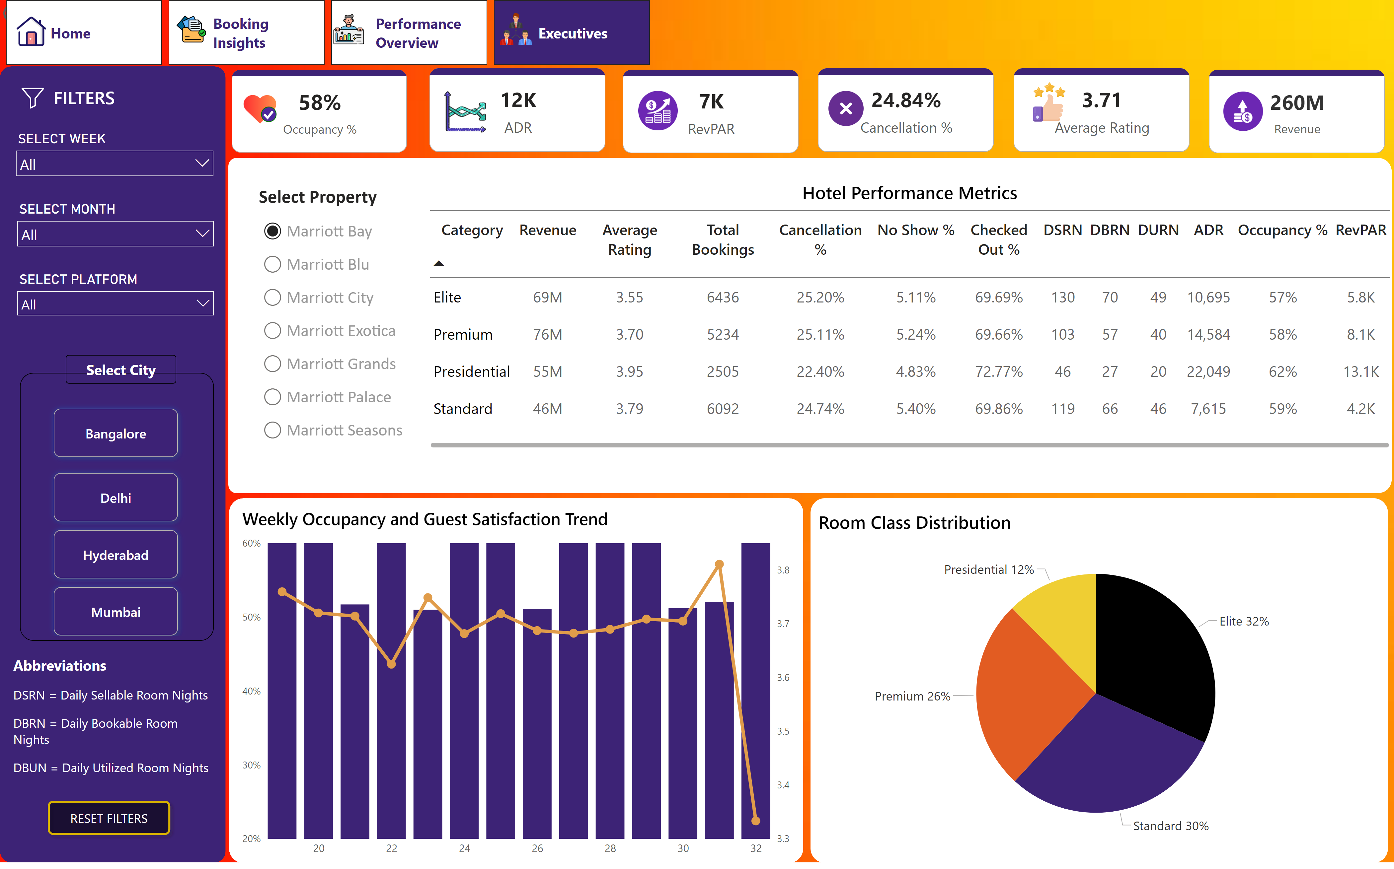
Executives
Notes:
shape
No alt text provided
slicer
No alt text provided
advancedSlicerVisual
No alt text provided
shape
No alt text provided
shape
No alt text provided
slicer
No alt text provided
actionButton
No alt text provided
image
No alt text provided
cardVisual
No alt text provided
slicer
No alt text provided
Hotel Performance Metrics
No alt text provided
shape
No alt text provided
Select Property
No alt text provided
shape
No alt text provided
cardVisual
No alt text provided
cardVisual
No alt text provided
cardVisual
No alt text provided
cardVisual
No alt text provided
cardVisual
No alt text provided
image
No alt text provided
image
No alt text provided
image
No alt text provided
image
No alt text provided
image
No alt text provided
Weekly Occupancy and Guest Satisfaction Trend
No alt text provided
shape
No alt text provided
shape
No alt text provided
Room Class Distribution
No alt text provided
textbox
No alt text provided
pageNavigator
No alt text provided
image
No alt text provided
image
No alt text provided
image
No alt text provided
image
No alt text provided
image
No alt text provided
actionButton
No alt text provided
actionButton
No alt text provided

